Slide 1


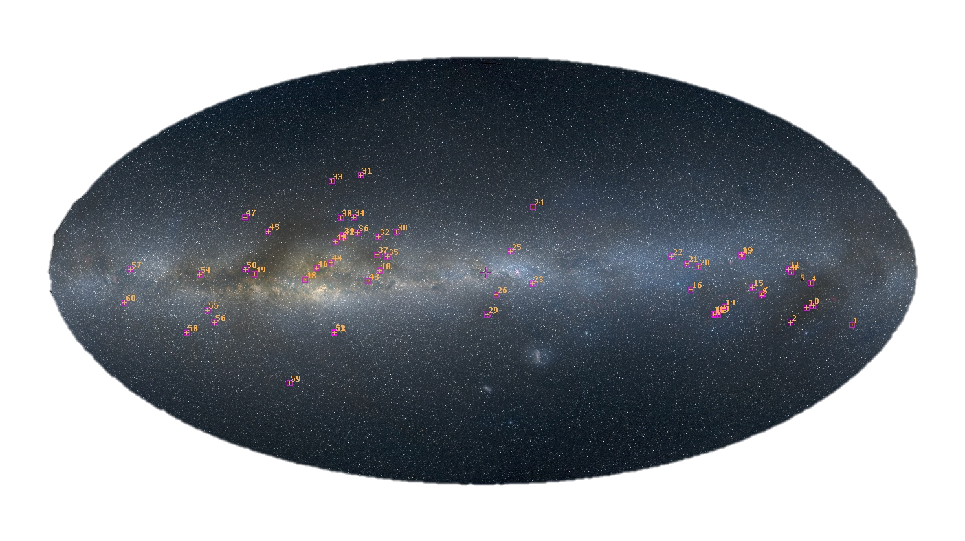
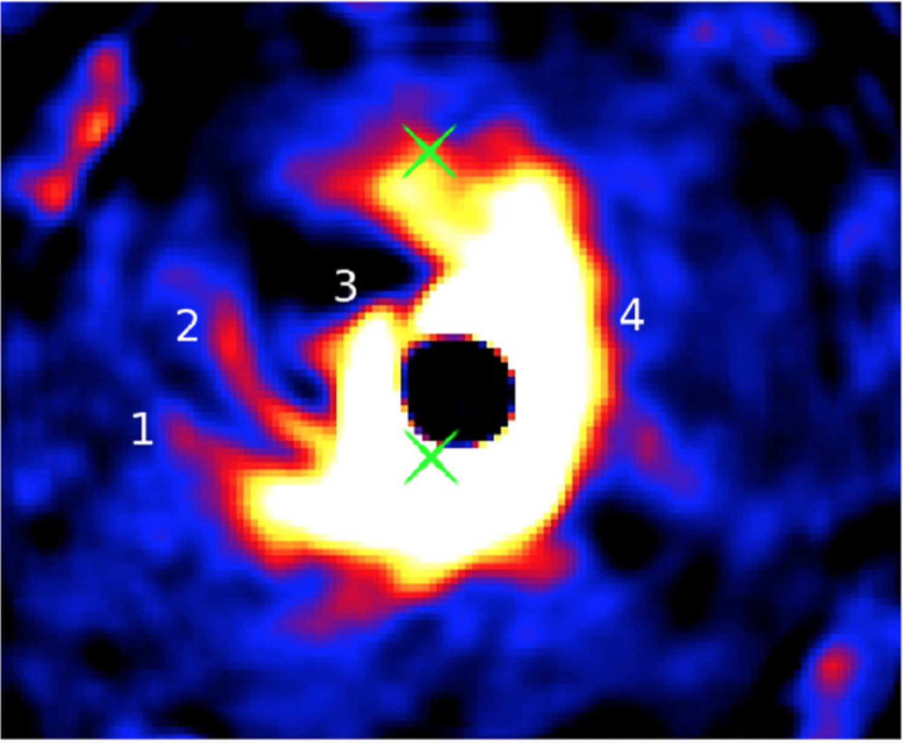
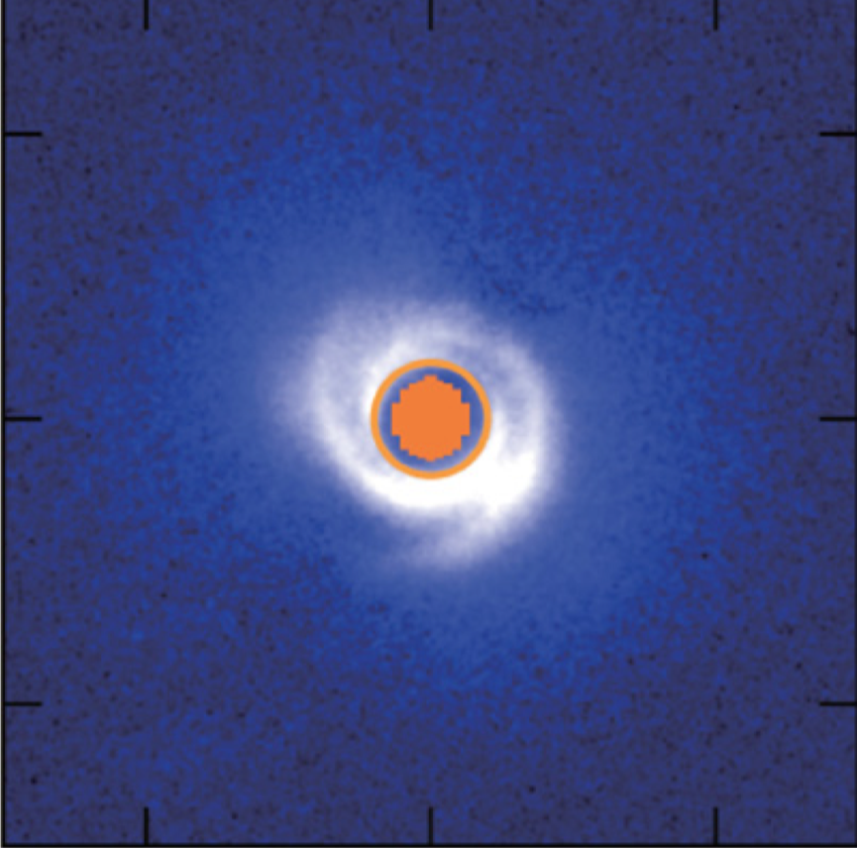
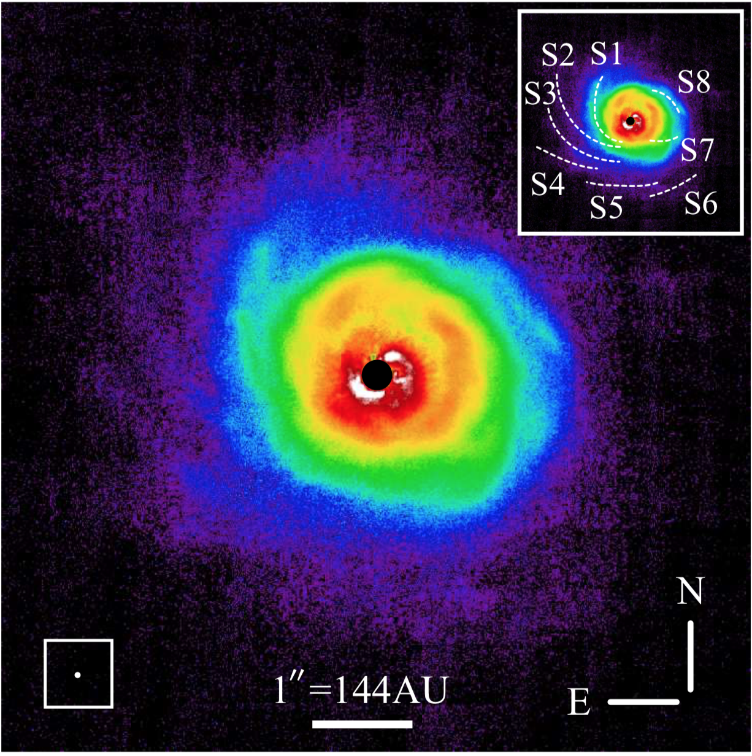

A High-Resolution Optical Spectroscopic Survey of Herbig AeBe Stars
A. N. Aarnio (University of North Carolina Greensboro), J. D. Monnier (University of Michigan)
Abstract: We present an atlas of high-resolution optical spectra of Herbig AeBe stars, pre-main sequence objects bridging the gap between high- and low-mass star formation. Our data are from the Magellan Inamori Kyocera Echelle (MIKE) double echelle spectrograph and span a range of ~3200-9000Å. We analyze and categorize spectral line morphologies and comment on their relationship with stellar parameters derived from the spectra and the literature. A preliminary discussion of coordinated interferometric measurements, part of a broader Michigan Young Stellar Object program, is also presented.
Our survey targets, plotted over optical all-sky data.
Our Survey: To assemble our sample, we searched SIMBAD (Wenger et al. 2000) for all stars designated Herbig AeBe or YSO in the observable declination range for Magellan Observatory. We further narrowed down the sample by including infrared excess and prioritizing targets with interferometric data available to constrain inclination and inner disk edge location. Over the years from 2006-2013, we observed ~60 Herbig AeBe and intermediate-mass T Tauri stars (positions mapped in middle panel).
H-R diagram for the sample. Orange diamonds: Gaia distances (Bailer-Jones et al. 2018) and G magnitudes used to calculate M_{bol,} T_{eff} from Gaia DR2 (Gaia Collaboration, 2018). Purple diamonds: M_{bol} as above, T_{eff} derived from literature spectral types and pre-main sequence temperature/spectral type scale of Kenyon & Hartmann (1995). PMS tracks of Siess et al. (2000), from 1-7 M⦿. Ongoing modeling of spectra aims to resolve large discrepancies in T_{eff}.
Data were reduced using the MIKE IDL pipeline (Bernstein, Burles, & Prochaska, 2015) and assorted post-pipeline processing routines written by the authors. Blaze and continuum removal were performed on 2D spectra, and orders were joined to form one normalized spectrum across the entire MIKE wavelength range. Equivalent widths were measured for an assortment of lines diagnostic of accretion and circumstellar processes. Where possible, spectral lines were fitted with multiple Gaussian components (see Aarnio et al. 2017) to separate emission and absorption (the latter likely due to winds).
Infrared color-color diagram for our sample (2MASS and WISE; Cutri et al. 2003, 2013), with directly imaged reference objects to demonstrate kinds of disks observed around objects in various locations of the diagram.
Currie et al. (2015)
HD 100546
Muto et al. (2012)
HD 135344B
AB Aur
Hashimoto et al. (2011)
Example SEDs and spectra for objects with well-constrained inclinations from interferometry. We find no objects in our sample with inverse P-Cygni Ha profiles. We are currently assessing relationships between inclination and observed line profiles.
Future work
Spectra will be published in 2018 and made available online. Data products to be published will include:
Equivalent width tables
Homogeneously derived stellar parameters: T_{eff}, log(g), metallicity, v*sin(i), radial velocity
Spectral energy distributions
Future publications will focus on radiative transfer modeling to reproduce the observed line profiles.
Background image credit: NASA, ESA, the Hubble Heritage Team (STScI/AURA), A. Nota (ESA/STScI), and the Westerlund 2 Science Team
Accessible .pptx
Notes:
From top to bottom on plot
HD_100546 2.97000 6.68200
HD_135344_B 3.07100 3.77900
AB_Aur 4.26700 3.39200
Qr code goes to http://aliciaaarnio.solar/stellar/files/aas233_poster.pptx

